Slide 1


Micro Credit Loan Defaulter Prediction
By- Khushboo Khatri

Slide 2


THINGS TO DISCUSS
Introduction
Analytical Problem Framing
Data Preprocessing (include Feature Engineering, EDA, Data Cleaning, Encoding)
Skewness and Outlier Detection and Removal
Scaling
Model Building
Summarizing /Conclusion
Saving the Model

Slide 3
Introduction
Problem Statement: A Microfinance Institution (MFI) is an organization that offers financial services to low income populations. MFS becomes very useful when targeting especially the unbanked poor families living in remote areas with not much sources of income. The Microfinance services (MFS) provided by MFI are Group Loans, Agricultural Loans, Individual Business Loans and so on.
Many microfinance institutions (MFI), experts and donors are supporting the idea of using mobile financial services (MFS) which they feel are more convenient and efficient, and cost saving, than the traditional high-touch model used since long for the purpose of delivering microfinance services. Though, the MFI industry is primarily focusing on low income families and are very useful in such areas, the implementation of MFS has been uneven with both significant challenges and successes.
Today, microfinance is widely accepted as a poverty-reduction tool, representing $70 billion in outstanding loans and a global outreach of 200 million clients.
We are working with one such client that is in Telecom Industry. They are a fixed wireless telecommunications network provider. They have launched various products and have developed its business and organization based on the budget operator model, offering better products at Lower Prices to all value conscious customers through a strategy of disruptive innovation that focuses on the subscriber.
They understand the importance of communication and how it affects a person’s life, thus, focusing on providing their services and products to low income families and poor customers that can help them in the need of hour.
They are collaborating with an MFI to provide micro-credit on mobile balances to be paid back in 5 days. The Consumer is believed to be defaulter if he deviates from the path of paying back the loaned amount within the time duration of 5 days. For the loan amount of 5 (in Indonesian Rupiah), payback amount should be 6 (in Indonesian Rupiah), while, for the loan amount of 10 (in Indonesian Rupiah), the payback amount should be 12 (in Indonesian Rupiah).
The sample data is provided to us from our client database. It is hereby given to you for this exercise. In order to improve the selection of customers for the credit, the client wants some predictions that could help them in further investment and improvement in selection of customers.

Slide 4
Analytical Problem Framing
Problem Framing: Build a model which can be used to predict in terms of a probability for each loan transaction, whether the customer will be paying back the loaned amount within 5 days of insurance of loan. In this case, Label ‘1’ indicates that the loan has been paid i.e. Non- defaulter, while, Label ‘0’ indicates that the loan has not been paid i.e. defaulter.
Mathematical/ Analytical Modeling of the Problem: Micro credit Loan Defaulter is a dataset consist of 37 columns and 209593 rows, here the main objective is to find out if the loan will be paid on time (non defaulter, 1), or will not be able to pay the loan on time (Defaulter, 0). We can clearly observe that in the label the number of 0’s are way less than number of 1’s in the dataframe. Which implies that our label is imbalance. One of the two things can be done here in this case, we can leave it as it is , as it denotes 0 or We can apply sampling (over/under) in order to manage this imbalance.

Slide 5
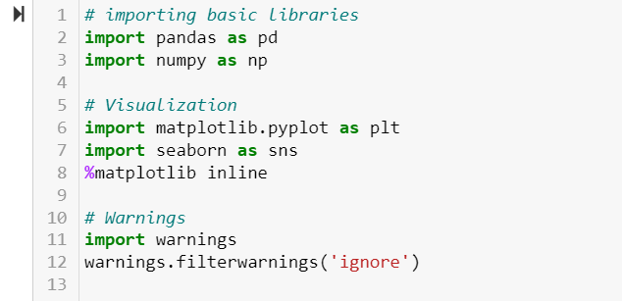
Starting with Jupyter NoteBook
Importing Basic Libraries.
These are basic libraries which one need to import in order start with the Model building approach, as it helps in getting the dataset, visualization etc.

Slide 6
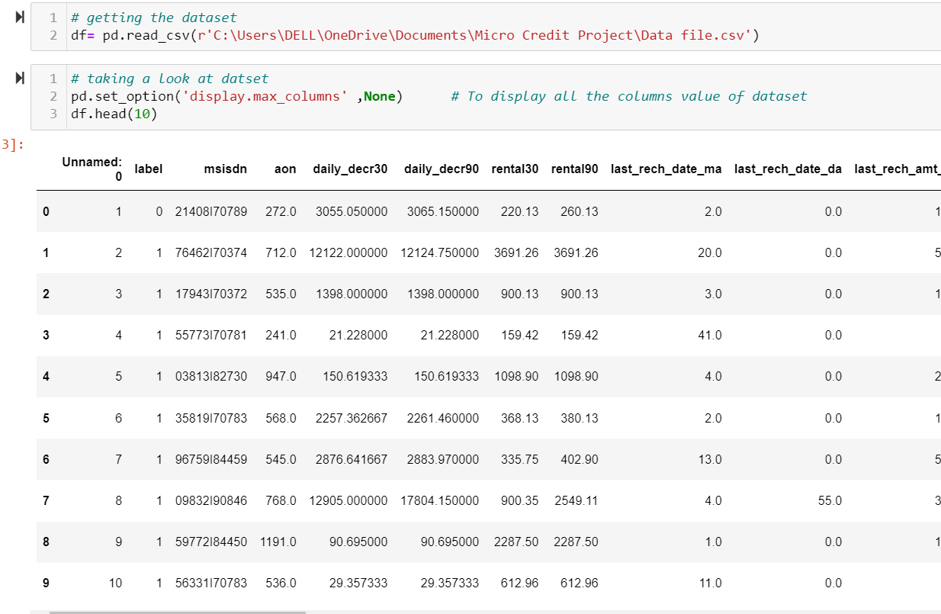
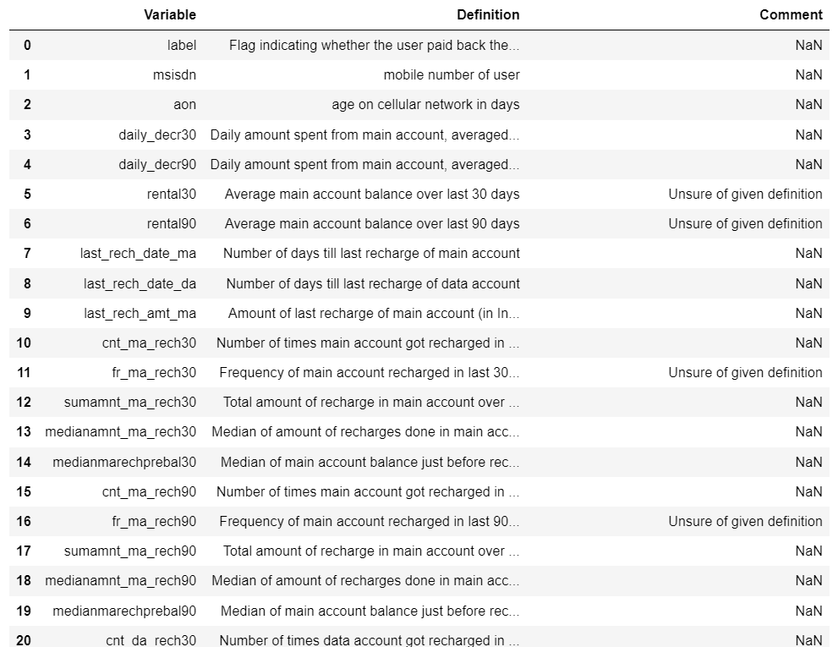
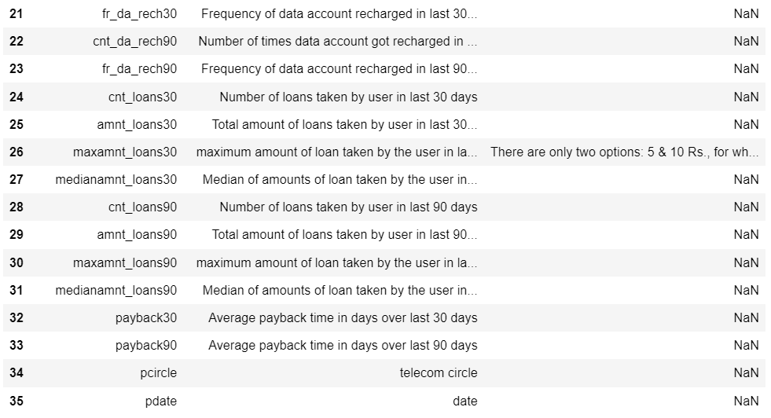
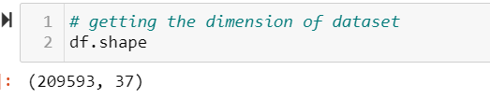
Data Source and their Format

Slide 7
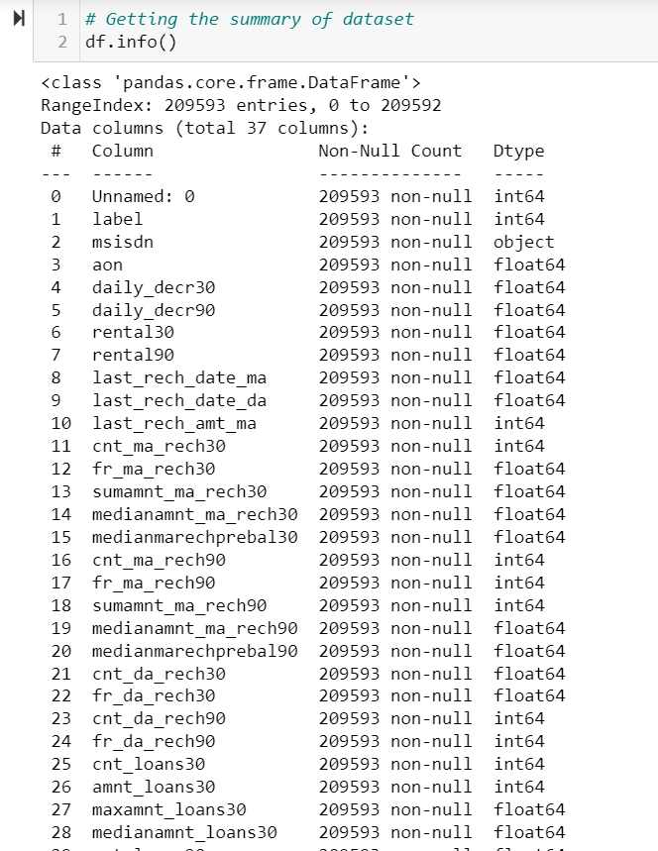
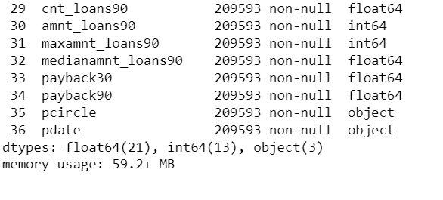
From here we can observe that we don’t have any null values in our dataset. Except msisdn, pcircle and pdate all other columns are of continuous or numerical datatype. Those three are having Object datatype, i.e. they are categorical columns.

Slide 8
Data Preprocessing
Data preprocessing is a process of preparing the raw data and making it suitable for a machine learning model. It includes data quality assessment, data cleaning, data transformation, data reduction.
Here, our target column is label and rest are features column. From first look of the data can say that Unnamed: 0 and pcircle column don’t add much value to our model building, as Unnamed is like index column and pcircle has only one unique value in the entire dataset. So we can drop them.

Slide 9
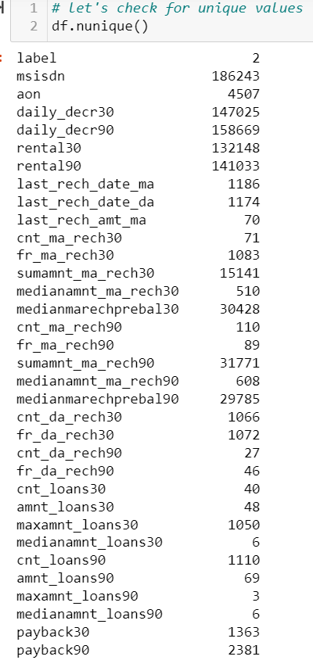
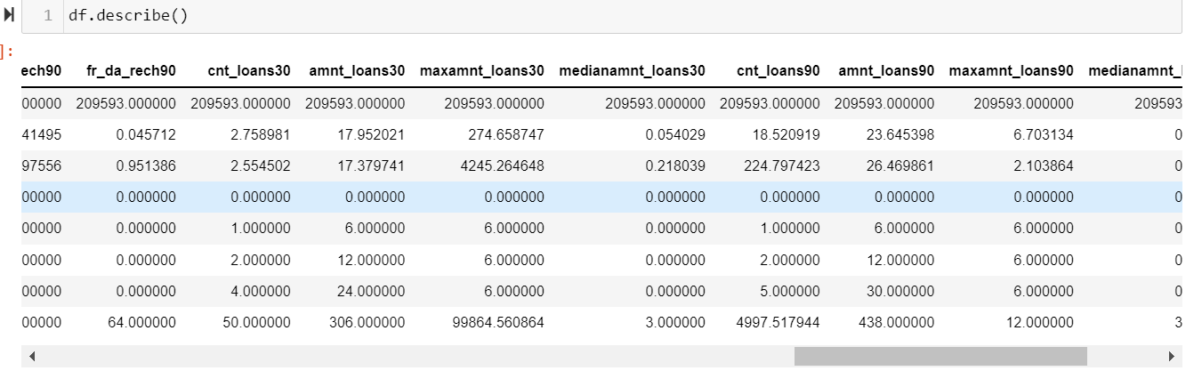
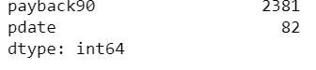
Checking for unique values in each columns using nunique() and then perform statistical analysis using describe ().
From above we did statistical analysis of the dataset, and we observe that the minimum zero value denotes that , some customers have no loan history.
We can observe that the label has only two unique classes, indication defaulter/not defaulter. It is a classification problem with target variable as label. In mobile number of user we can see that there are some mobile number which are repeated in the columns which are repeated in the columns

Slide 10
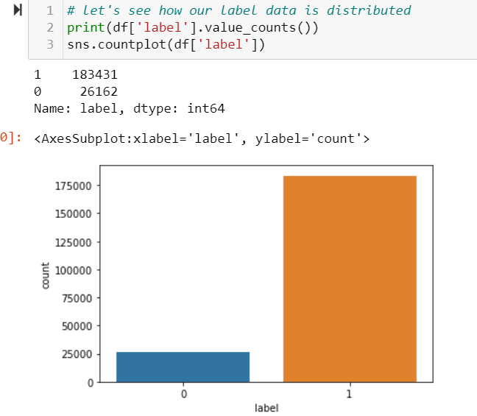
EDA
We will start with out data is distributed in our target column.
From the plot we can observe that the value for '1' and '0' is highly imbalanced, the number of 0 is way less than number of 1. But as this data is provided by the telecom company itself, we will not use any over sampling technique to handle this imbalance and undersampling can lead to information loss. '1' indicates non defaulter, '0' indicates defaulter.

Slide 11
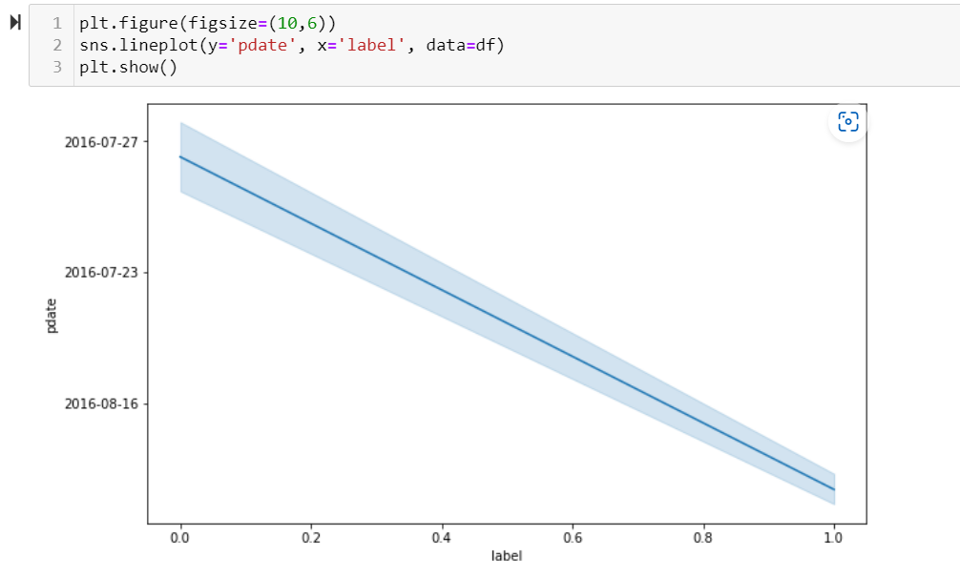
We can observe that on certain dates we got more defaulters , there might be some connection of date with label, so its better to feature engineer this columns, in order to get meaningful information from here.

Slide 12
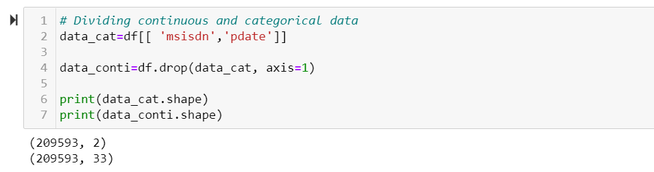
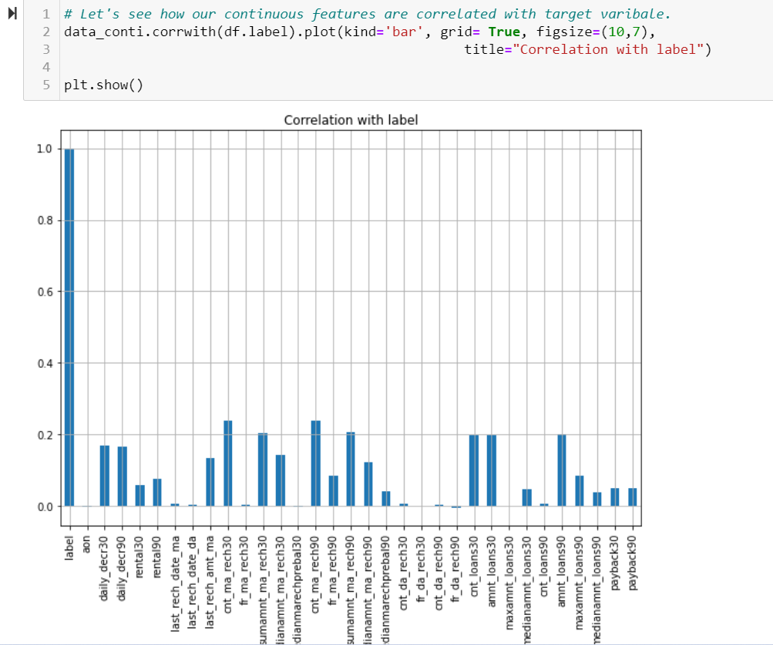
Separating Categorical and Continuous columns.
From here we can observe that cnt_ma_rech30 and cn_ma_rech90 seems to be most correlated features with or target variable label.
While aon, fr_da_rech30, maxamnt_loans30, medianmarechprebal30 are not atall correlated with label. Other features like last_rech_date_ma, last_rech_date_da, fr_ma_rech30, cnt_da_rech30, cnt_da_rech90, fr_da_rech90 and cnt_loans90 also shows nearly zero correlation with label.
Let's confirm it using correlation matrix, then we can drop these features columns with don't show any or nearly zero correlation with label.

Slide 13
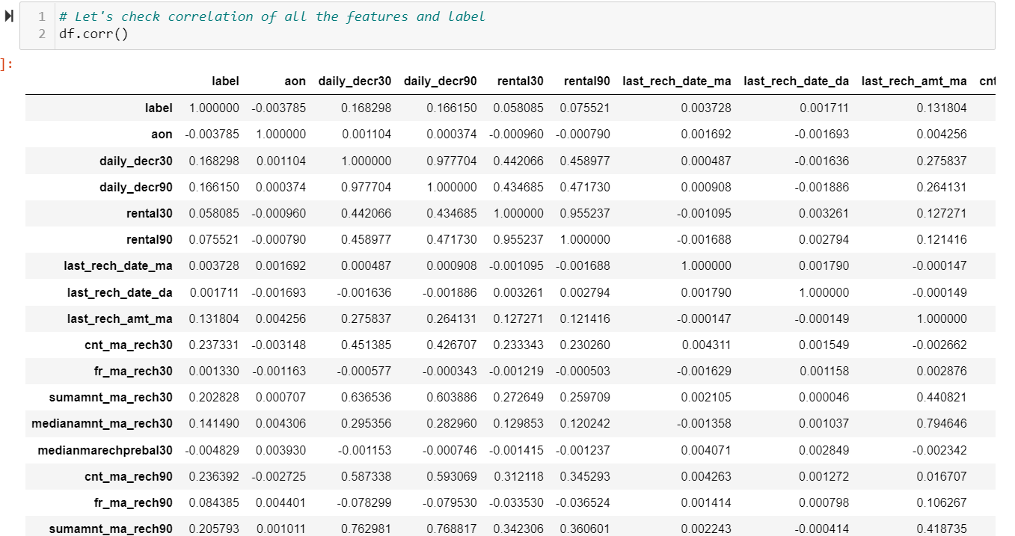
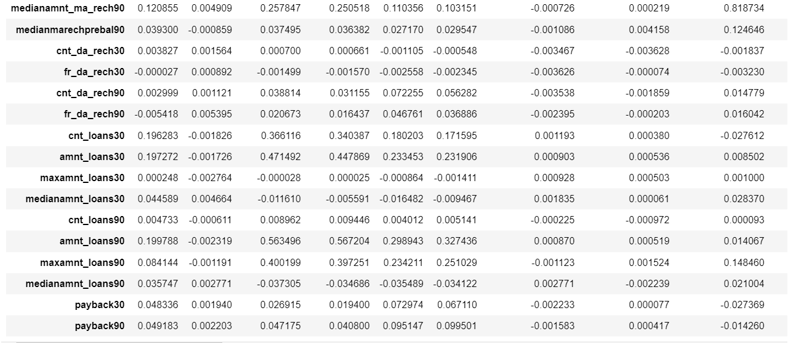
Determining the correlation among the features and label using .corr().
Correlation is a statistical measure that expresses the extent to which two variables are linearly related.

Slide 14
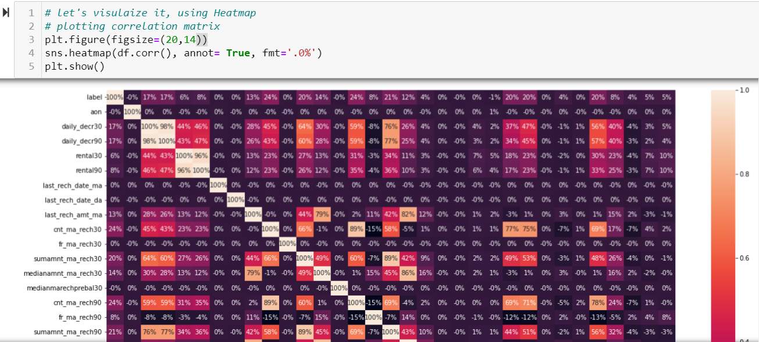
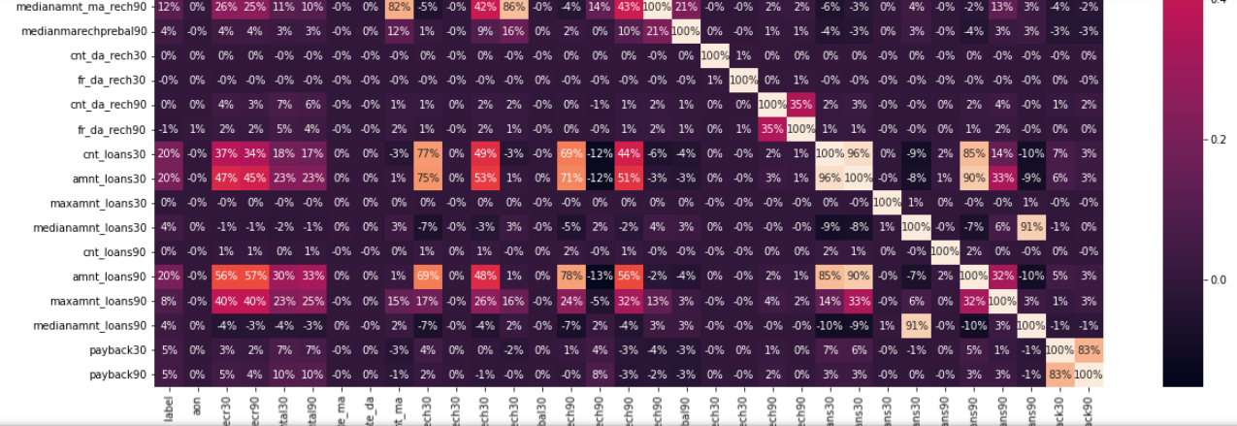
This is the visualization of Correlation Matrix, following are the Observation:
1. From above observation it is clear that, there are few columns which are 0 or almost 0 % correlated to label, so we will drop them for our ML model building.
2. These includes : 'cnt_loans90', 'maxamnt_loans30', 'cnt_da_rech90', 'fr_da_rech30', 'cnt_da_rech30', 'medianmarechprebal30', fr_ma_rech30', last_rech_date_ma', last_rech_date_da', 'aon'. we can drop these, as they are zero or almost 0% correlated with label.
3. We can observe that some features shows strong correlation with each cnt_loans30 - amnt_loans30, daily_decr30 - daily_decr90, rental30- rental90, medianamnt_loans90- medianamt_loans30, sumamnt_ma_rech30 -sumamnt_ma_rech90.

Slide 15
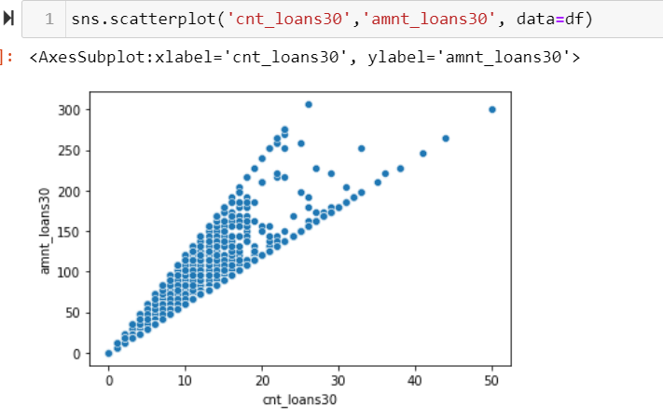
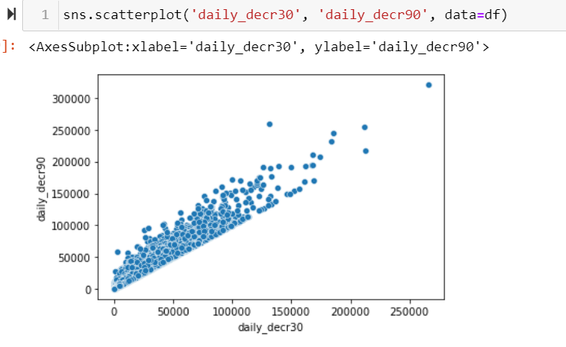
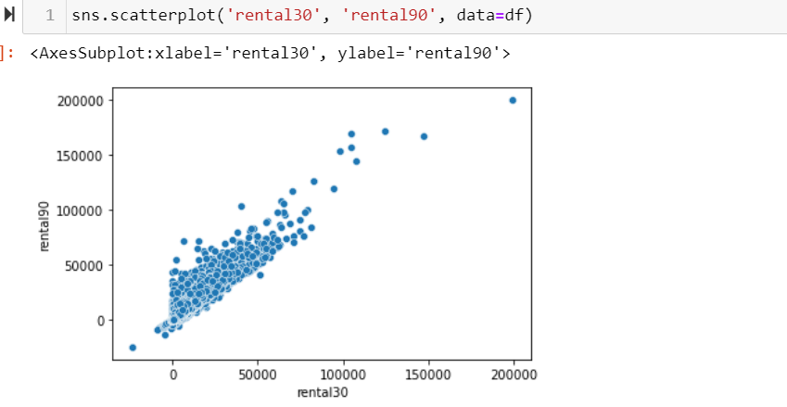
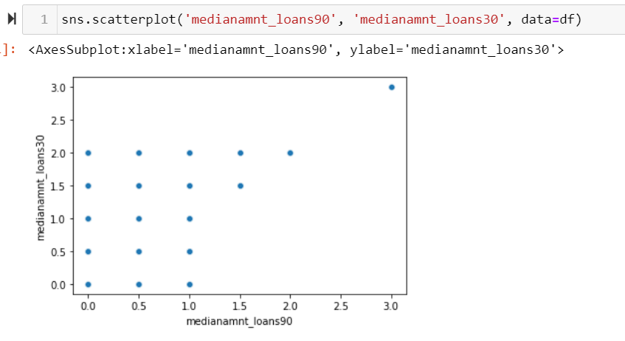
Plotting Scatterplot in order to determine the correlation among these features, and if they are correlated we need to drop one of them in order to prevent multicollinearity in the Model.

Slide 16
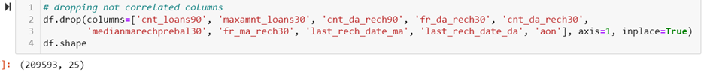
Dropping all the unwanted columns. It includes all the not correlated columns, and strongly correlated independent variables in order to reduce multicollinearity.

Slide 17
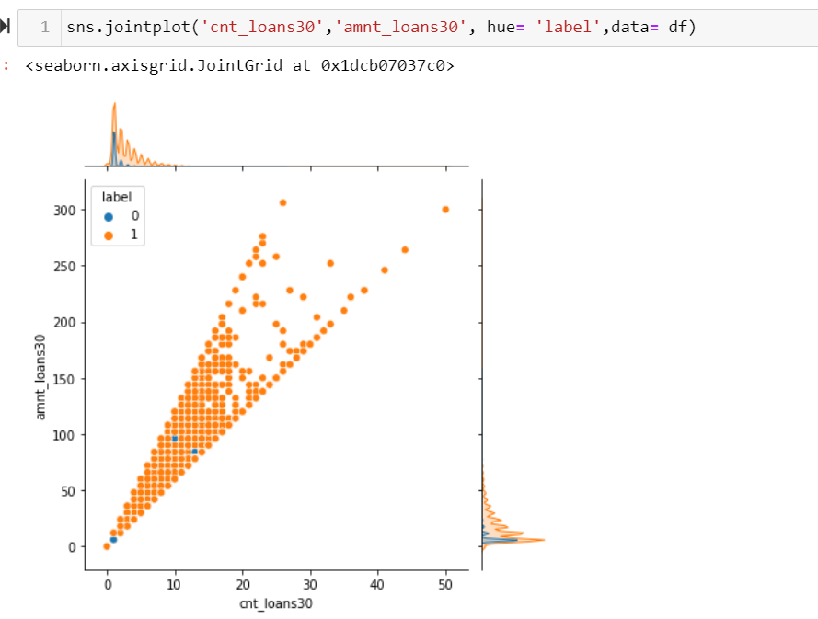
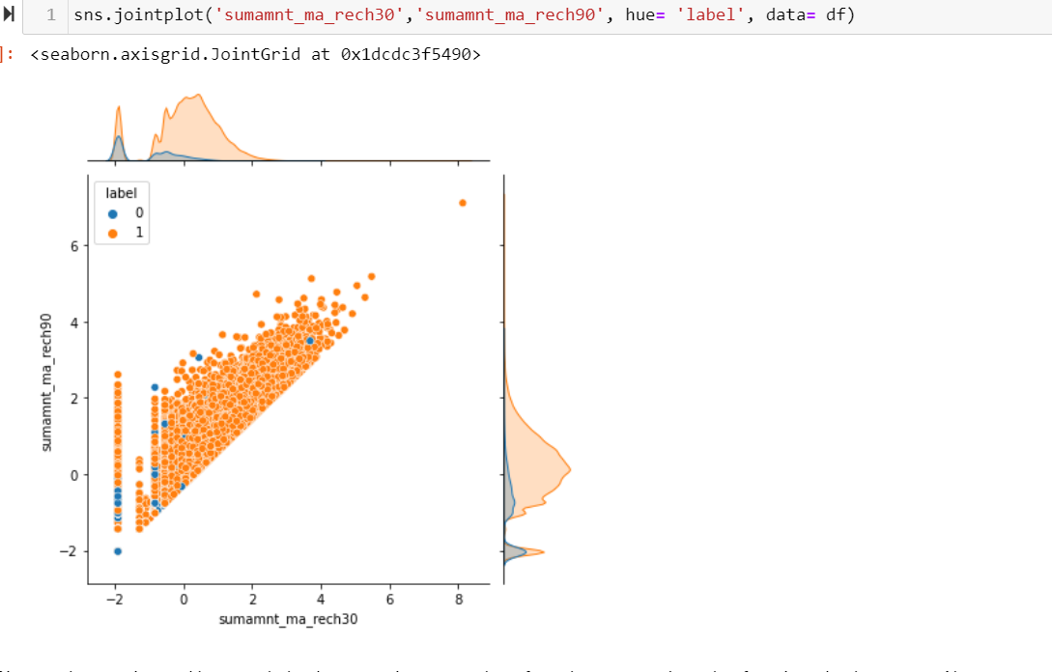
We can Observe that both are correlated , and there correlation with label seems to be the same. We can drop one of them. Let's drop cnt_loans30. From second plot we can observe the positive correlation between them, as value of one increases , the value for other also increases. Also we can see they shows exact plots with label. So it would be good if we drop one of them.

Slide 18
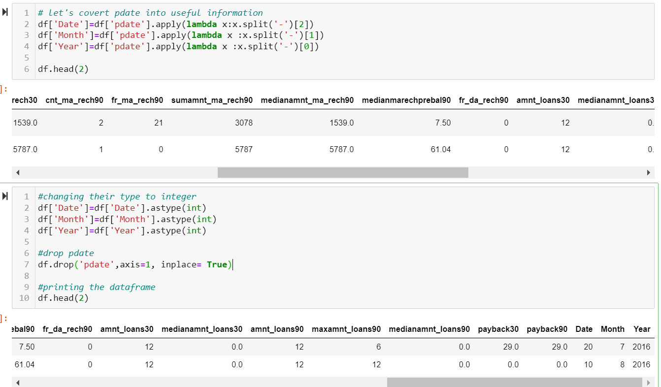
Let’s Perform some Feature Engineering On pdate, in order to come up with some meaningful information for our ML Model building.

Slide 19
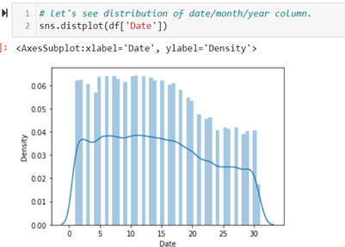
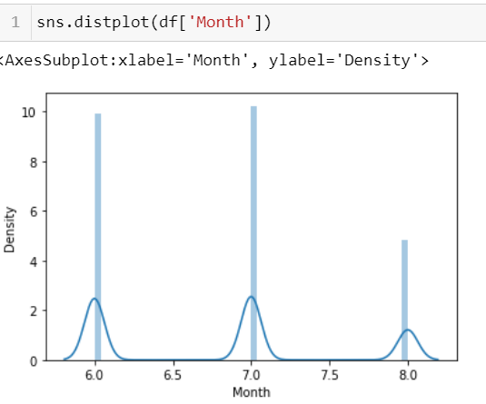
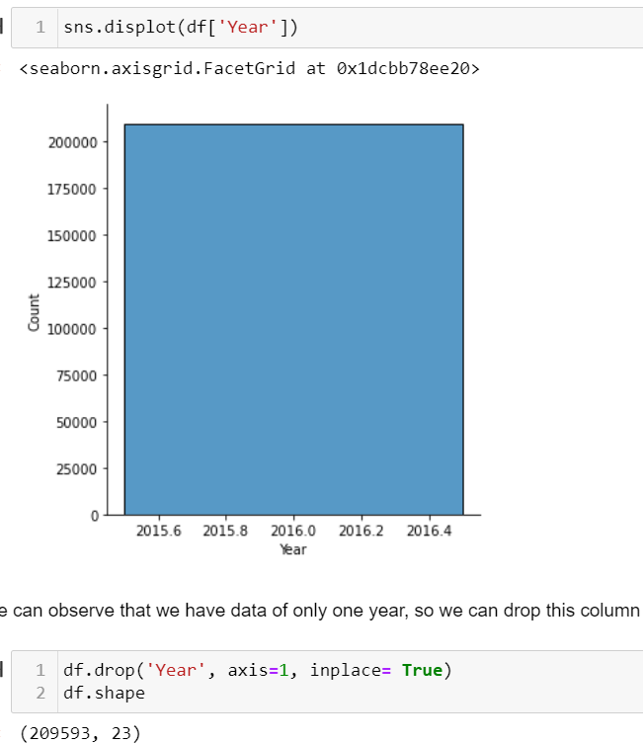
We can see the distribution of our new date month and year column, here we observe that year column consist of single unique value throughout the column, it’s better to drop it.

Slide 20
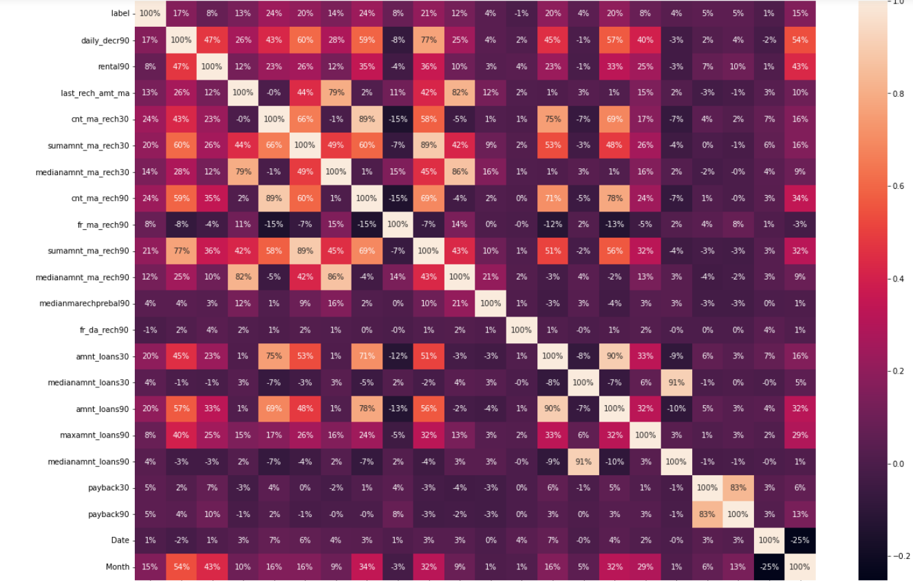

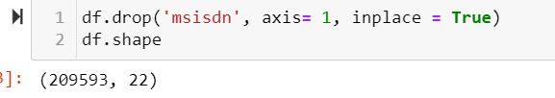
In order to find out the correlation of Date and Month column with label and rest of features , let’s plot Correlation Matrix one more time.
Observation : So far, the data looks good. Let's go ahead and do some drop user mobile number column, as it is merely an information about user identity, like name etc. It is important for record keeping, but I don't think it is of any use for ML Model Building.

Slide 21
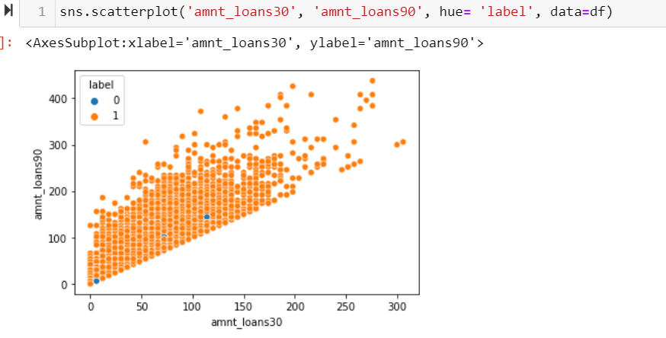
From above plot , we want to check the correlation between amnt_loans30- amnt_loans90, wrt label.
We can observe that both of them are positively correlated, but the variation in the response is quite big, so will keep both of them while going further.

Slide 22
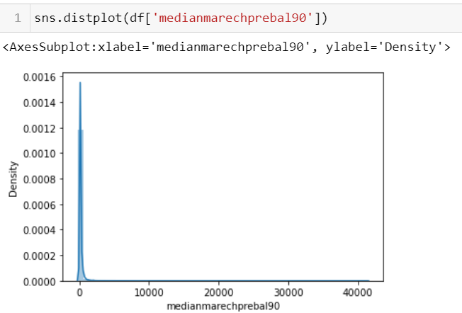
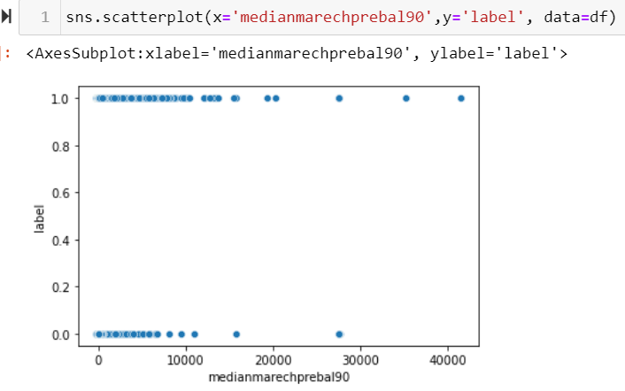
From above two plots it is clear that most of the values of medianmarechprebal90 lies around first highest peak and has wide distribution after that, that might be counted as outlier here, but maybe they are some valuable information, we need to be careful when removing outliers from here.

Slide 23
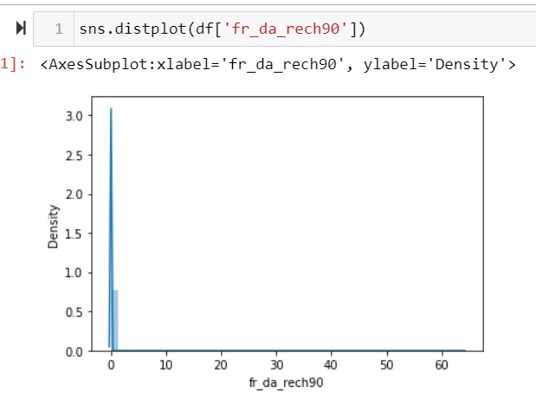
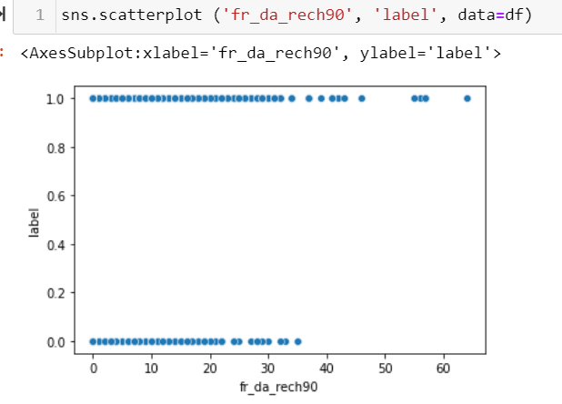
From above two plots it is clear that fr_da_rech90 has lots of outliers, but we can observe from the second plot that we got higher value for 1 in higher distribution, so they might be some useful info, we need to be extra careful while dealing with outliers.

Slide 24
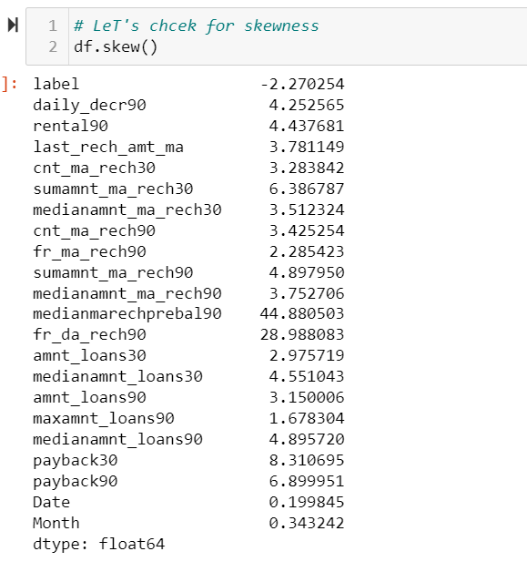
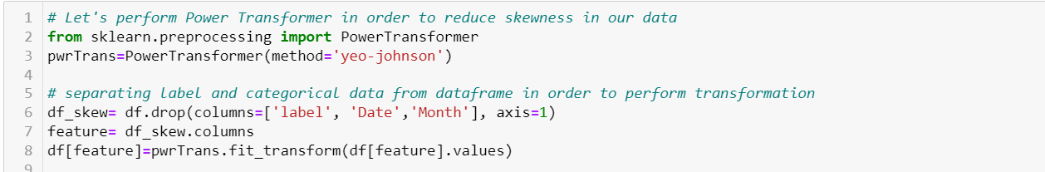
Skewness And Outlier Detection & Removal
From here we can observe that our dataset has lot of skewness and to reduce it, we can perform skewness removal technique like Power Transformer in order to reduce the skewness.
One thing to note here that any transformation can only be done on continuous features.

Slide 25
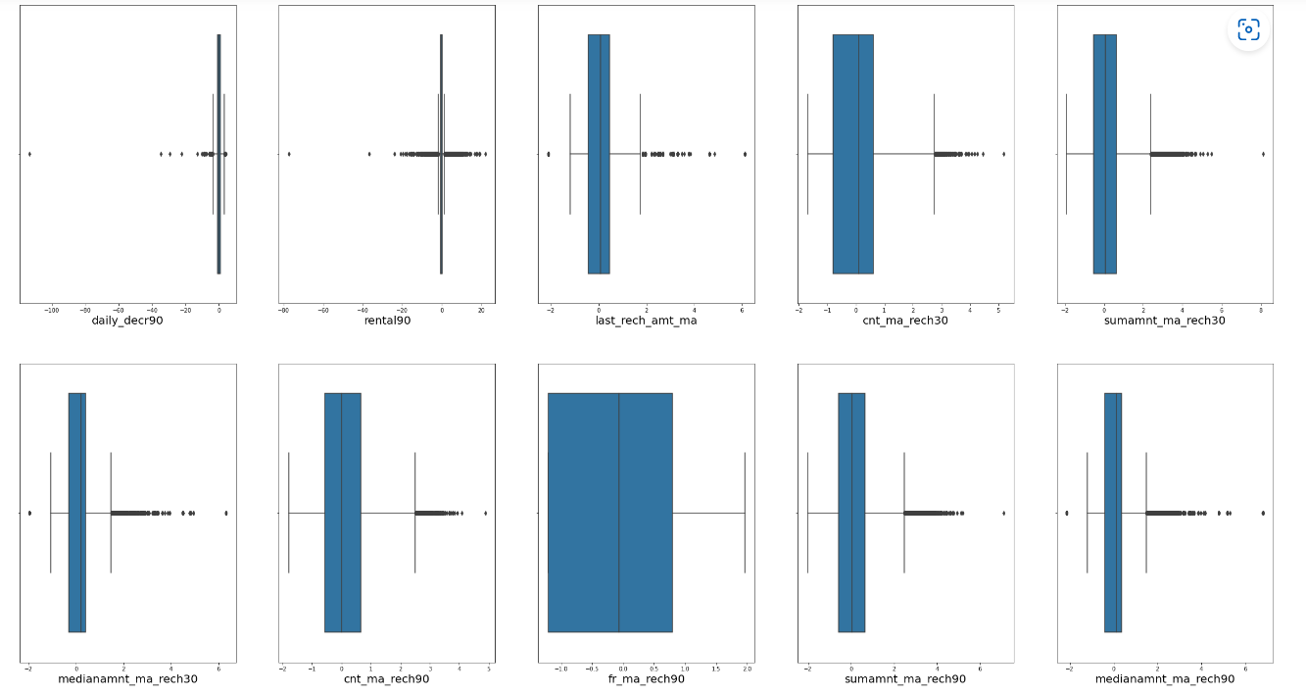
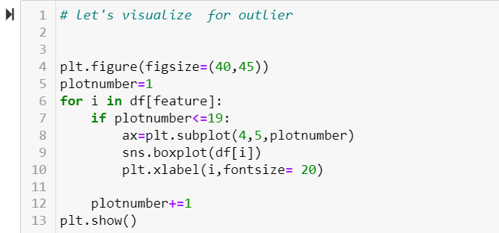
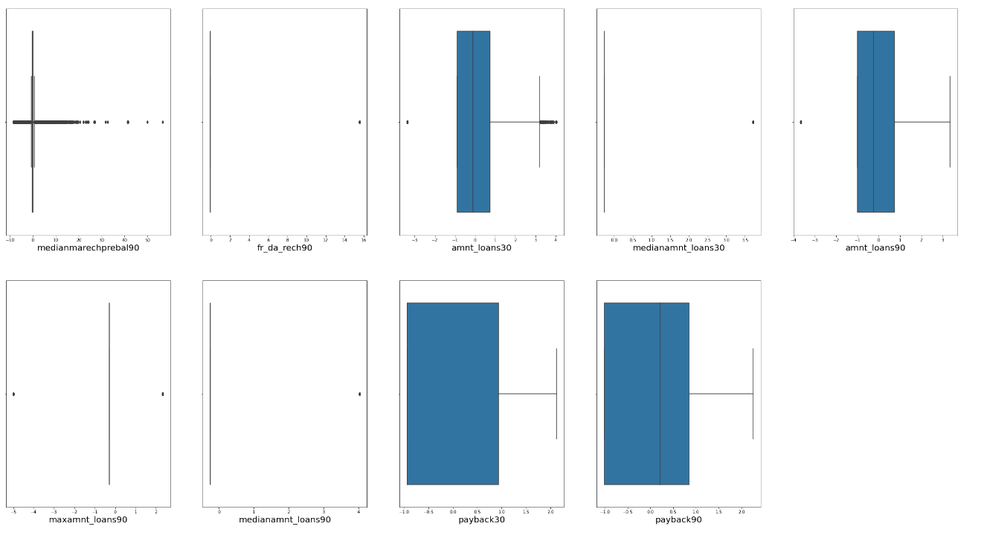
Outlier Detection using Boxplot
We can observe that some columns has some amount of outliers like medianmarechprebal90, daily_derc90, rental90, last_rech_amt_ma, sumamnt_ma_rech30, sumamnt_ma_rech90, medianamnt_ma_rech90.

Slide 26
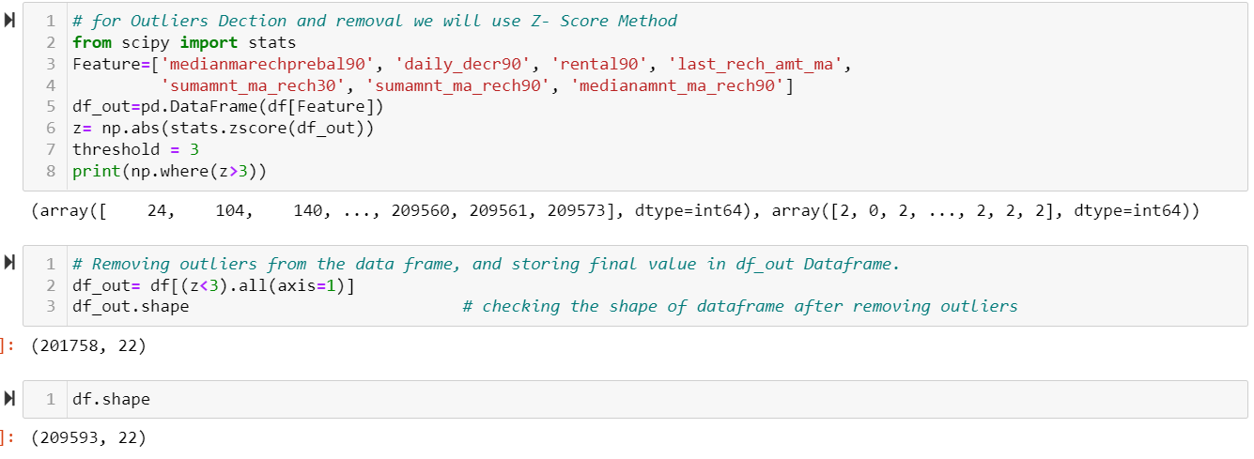
Using Z score technique to remove outliers.
The data loss is around 4% which is acceptable, we will move ahead without clean data, which is df_out. Let's separate label and features, and scale our data.

Slide 27
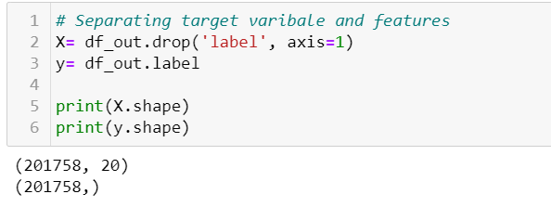
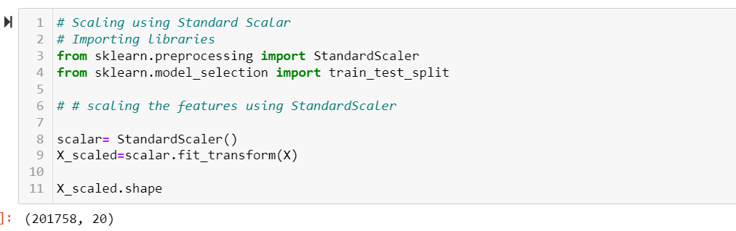
Scaling of Feature Columns:
We use StandardScaler technique to scale our dataset. As we discussed earlier any transformation happens only on features, we cannot transform our target variable, so here also we start with separating features and label. And then we perform transform on features only.

Slide 28
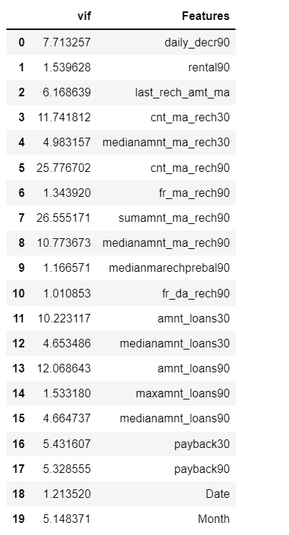
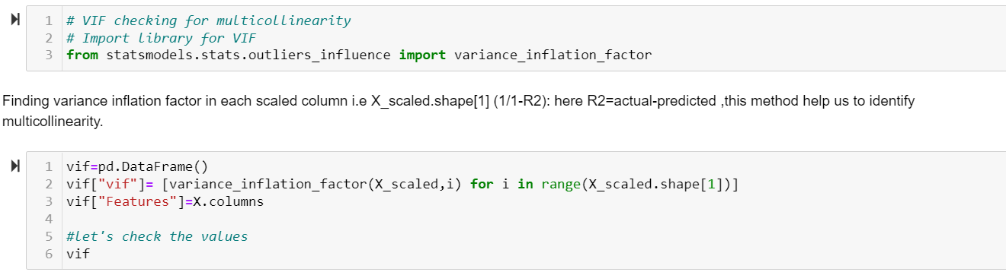
Variance Inflation Factor (VIF) We use this technique in order to determine the multicollinearity present in the dataset.
Taking a threshold of +/-10 for vif score, We can see that high multicollinearity is present in our dataset. To reduce this we need to drop the column with highest number of vif score. By dropping those columns , it will help to reduce over all score goes down.

Slide 29
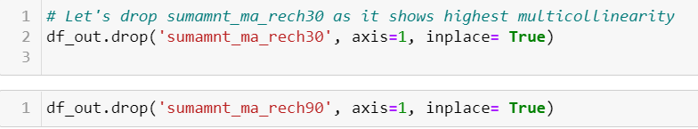
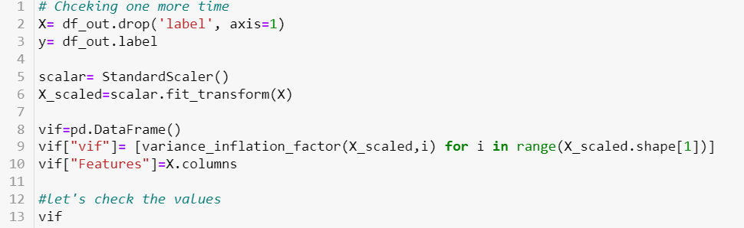
From here we can observe that by dropping those columns the multicollinearity of over all dataset reduce significantly.
However, for one or two columns the vif score is marginally higher than 10, We can drop them as well, but in my opinion , let’s keep them, as its real life data, and I don’t want to tampered more valuable information.

Slide 30
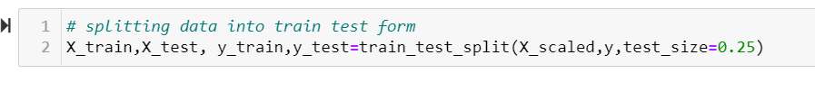
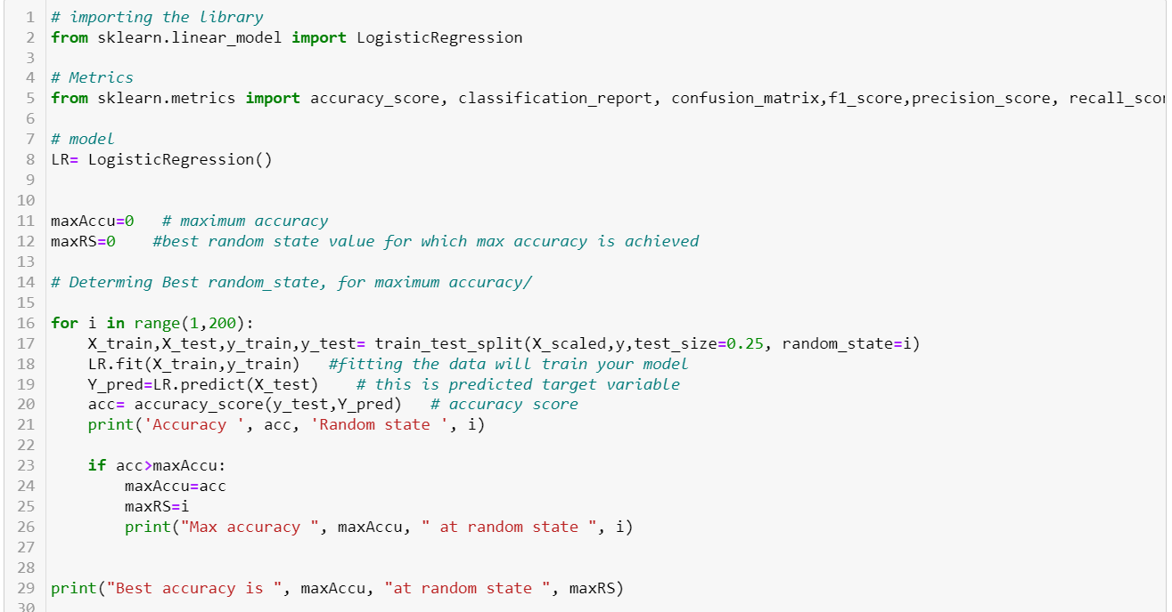
Model Building: As it is a classification Problem, we can perform Logistic regression, knn classifier, random forest classifier and so on. Let’s starts with Logistic regression

Slide 31



Logistic Regrssion

Slide 32
We can observe that our model work fairly decent, the deciding metrics which we are looking at is accuracy and classification report.
For cross validation the scoring is precision score, it gives us clear idea about how well our model is Identifying 1 & 0.
In Logistic Regression the main parameter which one need to tune is random state which we already did, so no further hyper parameter tuning is required.
Let’s perform couple more algorithm before we decide on best model for given dataset.

Slide 33



KNN Classifier

Slide 34
KNearestNeighborClassifier (KNN) also shows decent train and test scores.
We can observe that as compared to logistic regression, Knn works better, both in terms of accuracy and precision as well recall.
Let’s do an ensemble technique(Random Forest) and see how the scores are. As these techniques are robust techniques not get much affected by either multicollinearity or imbalance of data.

Slide 35



Ensemble Technique (RandomForest Classifier)

Slide 36

We can observe that Random forest performs better then both our previous model, let’s go ahead and do hyper parameter tuning, in order to increase its efficiency.

Slide 37



Boosting (GradientBoosting Classifier)

Slide 38

We can observe that GradientBoosting Classifier Model performs equally well as compared to randomforest, even here testing and training scores are almost in line. The trouble of over fitting / under fitting is not present, by cross validation we can surely see increase in the over score. This can be our model let’s do hyper parameter tuning in order to further increase its efficiency.
We can observe that both accuracy score and precision score increases slightly. This could be our model, before deciding on final model let’s build one more model.

Slide 39



SVC

Slide 40

SVC performs decent, however our random forest and gradient boosting classifier are the models with higher scores, and are performing better than this. We can perform hyper parameter tuning if we want to, anyways our final model will be either Random Forest or Gradient boosting classifier .

Slide 41

Summarizing We summarise each model in order to decide which model suits our dataset, and can be final model to save.

Slide 42

Conclusion
From the summarizing table we can conclude that RandomForest Classifier is our final model.
It has both highest accuracy and highest precision
Also it is one of the robust technique which was not much affected by multicollinearity and imbalance of data.
We can change the values of parameter in order to get higher hyper parameter tuning scores.
Lastly we need to save this model.

Slide 43
Thank you

